Slide 2
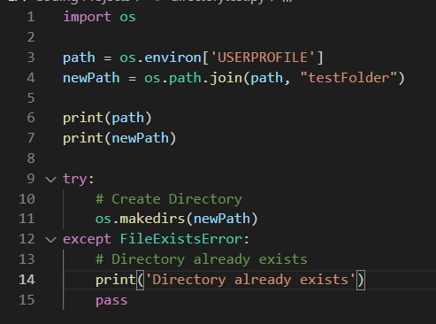
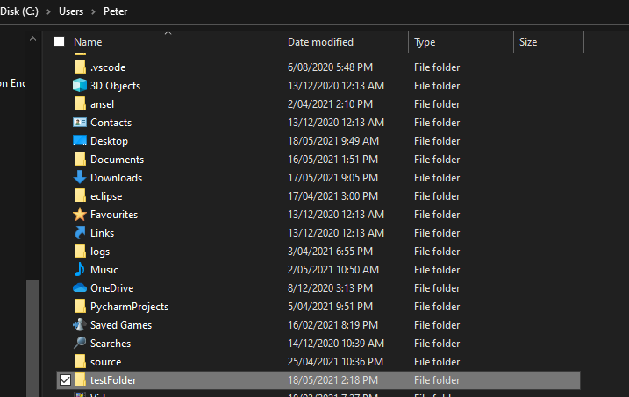
Sprint Subtask #1297 Windows
User Home Directory: %userprofile% (C:\Users\ProfileName)

Slide 3
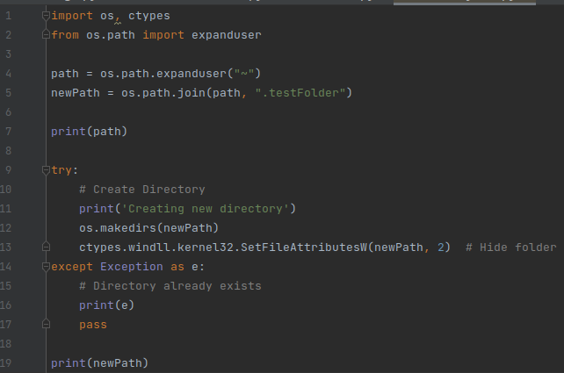
Sprint Subtask #1298 Linux

Slide 4
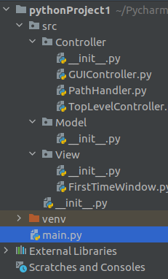

Slide 5
