Slide 1
Sprint20210506

Slide 2
Module – What is SQLite3?
SQLite is a self-contained, file based sql database

Slide 3
Connection
How to establish the connection?

Slide 4
Adapters and Converters
When and why do we need Adapters and Converters?
How to apply them?

Slide 5
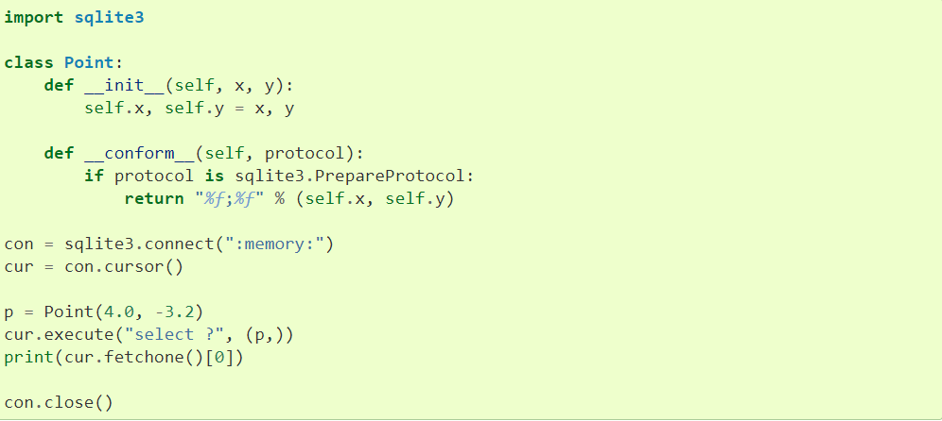
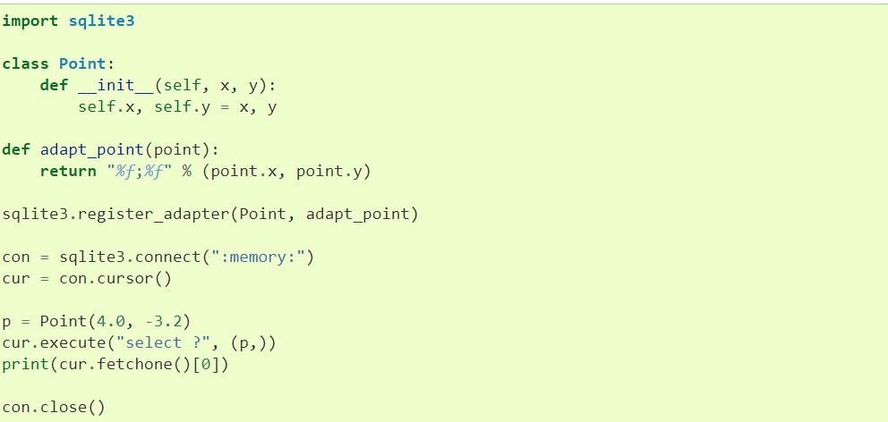
Adapters
#1
#2

Slide 6
Converters
Notes:
Variable substitution – security issue

Slide 7
Sprint Subtask #1255 - Cursor
Investigated Cursor Objects
Execute() – only one SQL statements
Executemany() – parameterized SQL
Cur.executemany(“insert into tableName values (?)”, variable)
Executescript(script)
Fetch, fetchmany(), fetchall() -> returns one, specified, all
Close() -> closes cursor
Rowcount
Lastrowid
Arraysize

Slide 8
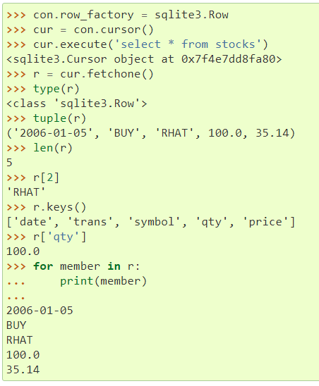
Sprint Subtask #1256 - Row
Investigated
Supports access by column name and index, iteration, equality testing and representation

Slide 9
Sprint Subtask #1267 – Learn and Train SQLite

Slide 10
SQLite – Exceptions
exception sqlite3.Warning A subclass of Exception.
exception sqlite3.Error The base class of the other exceptions in this module. It is a subclass of Exception.
exception sqlite3.DatabaseError Exception raised for errors that are related to the database.
exception sqlite3.IntegrityError Exception raised when the relational integrity of the database is affected, e.g. a foreign key check fails. It is a subclass of DatabaseError.
exception sqlite3.ProgrammingError Exception raised for programming errors, e.g. table not found or already exists, syntax error in the SQL statement, wrong number of parameters specified, etc. It is a subclass of DatabaseError.
exception sqlite3.OperationalError Exception raised for errors that are related to the database’s operation and not necessarily under the control of the programmer, e.g. an unexpected disconnect occurs, the data source name is not found, a transaction could not be processed, etc. It is a subclass of DatabaseError.
exception sqlite3.NotSupportedError Exception raised in case a method or database API was used which is not supported by the database, e.g. calling the rollback() method on a connection that does not support transaction or has transactions turned off. It is a subclass of DatabaseError.
exception sqlite3.Warning A subclass of Exception.
exception sqlite3.Error The base class of the other exceptions in this module. It is a subclass of Exception.
exception sqlite3.DatabaseError Exception raised for errors that are related to the database.
exception sqlite3.IntegrityError Exception raised when the relational integrity of the database is affected, e.g. a foreign key check fails. It is a subclass of DatabaseError.
exception sqlite3.ProgrammingError Exception raised for programming errors, e.g. table not found or already exists, syntax error in the SQL statement, wrong number of parameters specified, etc. It is a subclass of DatabaseError.
exception sqlite3.OperationalError Exception raised for errors that are related to the database’s operation and not necessarily under the control of the programmer, e.g. an unexpected disconnect occurs, the data source name is not found, a transaction could not be processed, etc. It is a subclass of DatabaseError.
exception sqlite3.NotSupportedError Exception raised in case a method or database API was used which is not supported by the database, e.g. calling the rollback() method on a connection that does not support transaction or has transactions turned off. It is a subclass of DatabaseError.

Slide 11
SQLite – Exceptions

Slide 12
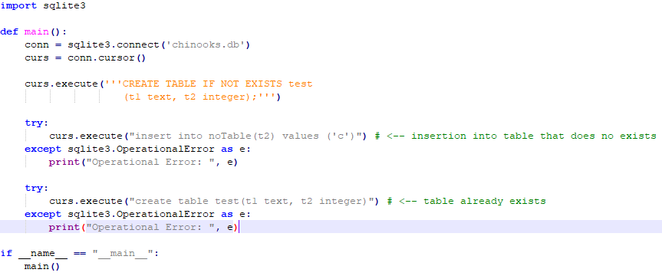
SQLite – Exceptions

Slide 13
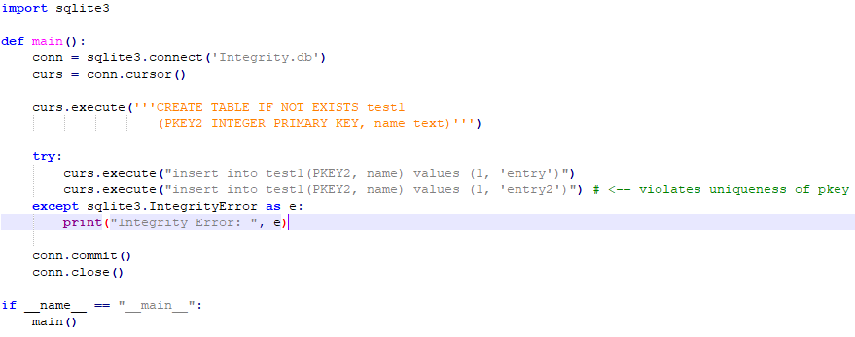
SQLite – Exceptions

Slide 14
SQLite – SQL and Python Types
Native data types supported by SQLite
This is how SQLite types are converted to Python types by default:
Python type | SQLite type
None | NULL
int | INTEGER
float | REAL
str | TEXT
bytes | BLOB

Slide 15
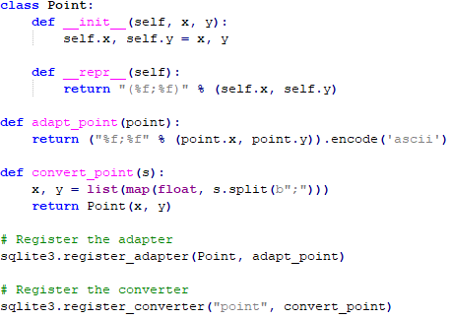
SQLite – SQL and Python Types
Adapters and Converters
To implement custom datatypes in SQLite we must define and register adapter and converter methods that describe how the custom datatype will be converted to and from the default SQLite datatypes.
Custom datatype example: Point

Slide 16
SQLite – SQL and Python Types
Adapters and Converters
Finally, we must let the SQLite module know when we are selecting a custom datatype.
This is done either implicitly through declared types or explicitly through column names
Note: There are default adapters for the date and datetime types in the datetime module.

Slide 17
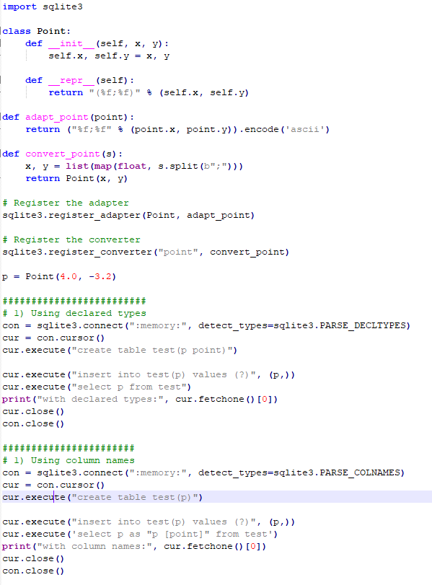
SQLite – SQL and Python Types
Adapters and Converters
Full example of custom datatype Point

Slide 18
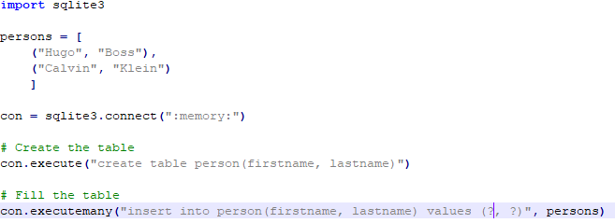
SQLite – Efficient methods
Using shortcut methods
It is possible to implicitly use a cursor by using the nonstandard methods execute(), executemany() and executescript() from the connection object.

Slide 19
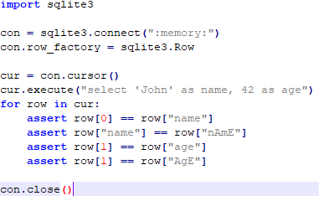
SQLite – Efficient methods
Accessing columns by name
Rows wrapped with the sqlite3.Row class allow for columns to be accessed by name (case insensitive) instead of just by index.

Slide 20
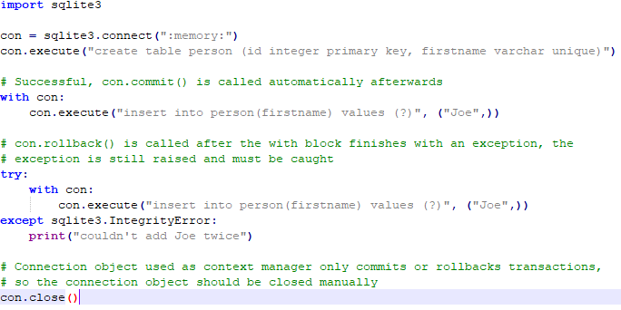
SQLite – Efficient methods
Using connection object as context manager
It is possible to use the connection object as a context manager that can automatically commit on successful statements and rollback when errors are raised.

Slide 21
Question SQLite3
Embedded only -> what kind of remote server would we connect to?

Slide 22
Configuration Files - Introduction
Located in src\data
All .csv files
line&fill_configuration is txt
Onko has a function resource_path(relative_file_path) that modifies the provided file path so python can process it
It’s feasible to store database file names in a new .csv folder to access
Note: visual recourses (fonts, images) and their configuration data is located in src\res

Slide 23
Configuration Files – accessing .csv
with open(file_directory.csv, [“w”, “r”], newline=“”) as stream
Opens the .csv file as the variable stream
Need to specify w or r for write or read respectively
reader = csv.reader(stream): opens the csv reader file in read mode
writer = csv.writer(stream) is the write mode equivalent
.csv data is accessed and stored as arrays
Each array is on a separate line
Each line has the format “var_1, var_2, var_3, …, var_n
writer.writerow(array) writes the array to the .csv
Reading requires iteration through each line and writing code to convert a string to an array

Slide 24
Configuration Files – Loading Directory
QtWidgets.QFileDialog.getExistingDirectory(None, “Select Directory:”)
Opens the file explorer dialog box to choose a directory
Returns the path of the chosen directory as a string
QtWidgets.QFileDialog.getOpenFileName(None, “Open File:”) is the equivalent for choosing a file

Slide 25
Onko Naming Conventions
Style - Overview
https://www.python.org/dev/peps/pep-0008/ - PEP 8
The universal style guide for python since 2001
PyCharm will give formatting hints for PEP 8
OnkoDICOM is completely compliant with its naming conventions
However, Onko is not completely compliant with PEP 8
Limit of characters per line is 79 or 72 if multilined
Continued line indentations

Slide 26
Onko Naming Conventions
Style – Specifics
Functions / Variables: lowercase with underscores (def my_function(), some_integer)
Constant variables are to be written in all capitals (PI, OTHER_CONST)
Use mixedCase in files where that’s the style (thisFunction(), anotherInteger)
Classes: CapWords (MyClass, ClassForNumbers)
Packages: short, all lowercase, underscores are discouraged (package)
Modules: CapWords
Mixed Case when calling / extending / inheriting from a mixed case class

Slide 27
Onko Naming Conventions
Style – Specifics
Naming: precise, readable, unique
Choosing names: Complete words, properly separated, correct spelling, descriptive
If a name needs to be adjusted to avoid collision, a different name needs to be chosen (e.g instead of function_a, function_b, use function_description1, function_description2)
Module Names:
For a class: module name must be identical to top level class in file
Other (e.g container for other classes): module must be appropriately named in relation to all functions and classes in the file

Slide 28
Wireframes- First-time Setting Window
1. First time users will be prompted to set their default directory by clicking the "Browse" button. They will be presented with options unless the configuration file only contains the path to the default directory.
2. When selected, a loading popup window will appear. The progress bar informs the user the status of loading the default directory.
3. Once selected, the user is asked to confirm their selected default directory by clicking on "Confirm" which will bring them to the "Display Open Patient" Window.
Note: The user can also skip this step by selecting "Skip".

Slide 29
Wireframes – Welcome Window
1. A Welcome page will greet returning users with randomised messages including tips on how to use the software (or continue with the existing welcome message of OnkoDICOM).
The OnkoDICOM logo will also be present and centered to increase brand recognition.
Heading of the window is titled "Welcome Window" to remind the user where they are.
There is only one interaction with this screen, which is clicking the "Next" button which will bring the user to the "Display Open Patient" window.

Slide 30
Wireframes – Display Select Patient Window
In this window, the user is prompted to choose the path of the folder that contains the DICOM files. The user does this by clicking "Choose", which will lead them to the "Select Folder" window.
Until a path has been selected, the user will not be able to click "Confirm" as no patient folders would have been selected.
Alternative flow: if there are no files found, a popup message will come up and the user will be asked to reselect the folder by clicking "OK".

Slide 31
Wireframes – Select Folder Popup Window
This "Select Folder" popup window appears when the user clicks on "Choose" from the previous view. The layout is similar to the existing "Select Folder" window in OnkoDICOM, however instead of having an "Open" button in the top right corner, the user is prompted to click "Confirm" down at the bottom right of the screen. They can also click "Cancel" if they do not wish to change the directory.
Existing search function as indicated by the magnifying glass icon remains the same.
Once either "Confirm" or "Cancel" is clicked, the user will be brought back to the "Select Patient" window, which should be updated with the patients' folders presented in a tree structure.

Slide 32
Wireframes- File Tree Structure
Upon selecting the folder, the path should be updated.
1. Patient files are displayed to the user in a tree structure. This allows the user to clearly see what DICOM files are available for each patient as well as minimise any patient folders with the up and down arrows. The user selects the patient files they wish to load by selecting the relevant checkboxes.
2. The user then selects "Confirm" to load the DICOM files available in that folder, which will be shown in the "Display Image" window.
NOTE: For the purpose of this presentation, the "Confirm" button will link to the "Error Message" window to show what happens in the event there are missing elements.
3. "Back" will bring the user back to the Welcome window
Tree structure in default directory is the fastest way to search - make search appear really really fast

Slide 33
Wireframes – Error Message
This "Error" window will appear if there are missing elements required for startup. These missing elements are listed in a dropdown list so that the user can clearly see what elements (ie. listfromAndreworStuart) they need to find.
2. The user has the option to proceed without fixing the missing elements by selecting "Open anyway".

Slide 34
Wireframes- Display Image
The "Display Image" window shows up once the DICOM file is successfully opened. Functions as indicated by the icons shall remain the same as the existing OnkoDICOM app.

