Slide 1
SPRINT: 20210429

Slide 2
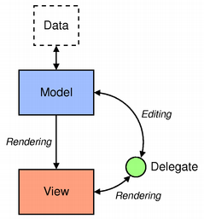
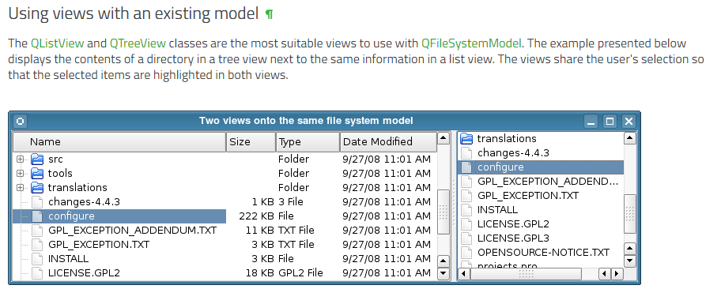
SPRINT#1196 Subtask: PyQt5 – View Class
Typical ways of displaying items
QListView
QTableView
QTreeView

Slide 3
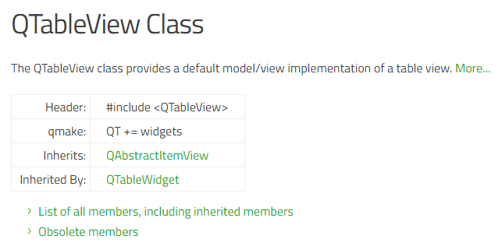
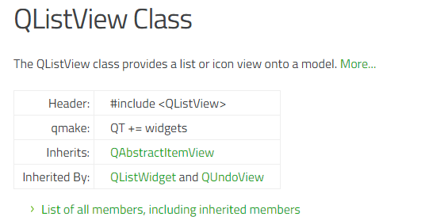
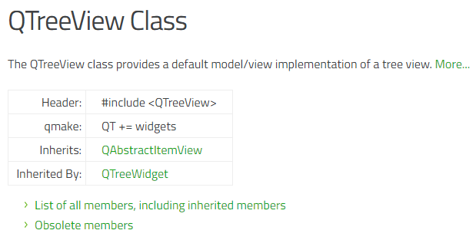
SPRINT#1196 Subtask: PyQt5 – View Class
Each View has their separate functions
https://doc.qt.io/qt-5/qlistview.html
https://doc.qt.io/qt-5/qtableview.html
https://doc.qt.io/qt-5/qtreeview.html

Slide 4
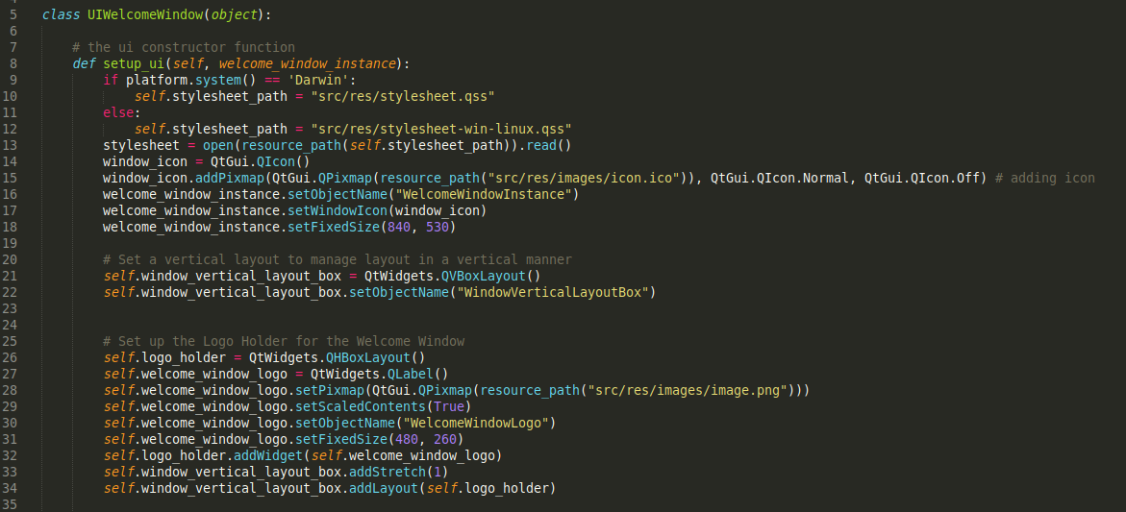
SPRINT#1196 Subtask: PyQt5 – View Class
View Class
Handles basic UI
Drag and drop
QTreeWidget
QListWidget
QTableWidget

Slide 5
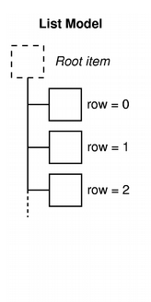
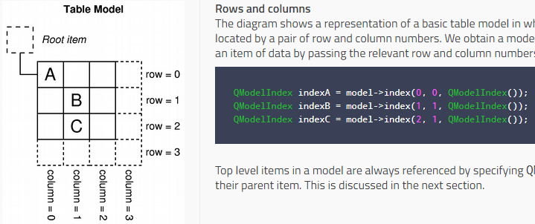
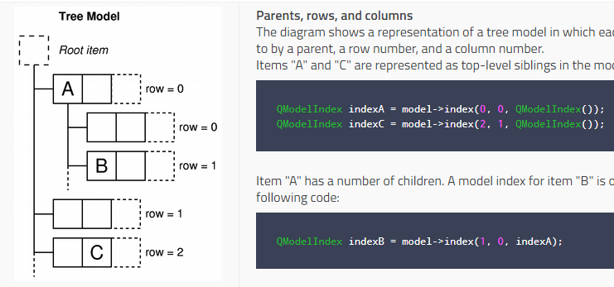
SPRINT#1196 Subtask: PyQt5 – Model Class
Model interface to access data
Model index -> keep data separate from the way it’s accessed

Slide 6
SPRINT#1196 Subtask: PyQt5 – Model Class
Ways to handle data
QAbstractItemModel
QStringListModel
QStandardItemModel
QFileSystemModel
QSqlQueryModel, QSqlTableModel, QSqlRelationalTableModel

Slide 7
SPRINT#1196 Subtask: PyQt5 – Delegate Class
Interaction between the user and data
Render contents themselves
Selection Model

Slide 8
SPRINT Subtask#1232 – Onko Source Code
Method:
Read the code
Interact with the application
Comment unrelated functionalities
Record what I’ve learnt
Progress:
I’ve looked at most of the View Classes and how they are used in the application
Interactions of the view with the Controller classes
Model classes (DICOMStructure)

Slide 9
SPRINT Subtask#1232 – Onko Source Code
Results:
Model Classes
Each class has their own data structure
With some basic IF-ELSE, FOR LOOP logics
DICOMStructure
DICOMStructure Class
Patient Class
Study Class
Series Class
Image Class
View Classes
UI
How each component is interacted

Slide 10
What still needs to be done
Look more into the Onko Source Code
Start creating mini examples of unrelated code to understand PyQt5 in practical terms
If it’s possible, start writing code to Learn and Train

Slide 11
Summary
Look at the product backlog
Experimented with source code
To do list for next week

